Slide 1

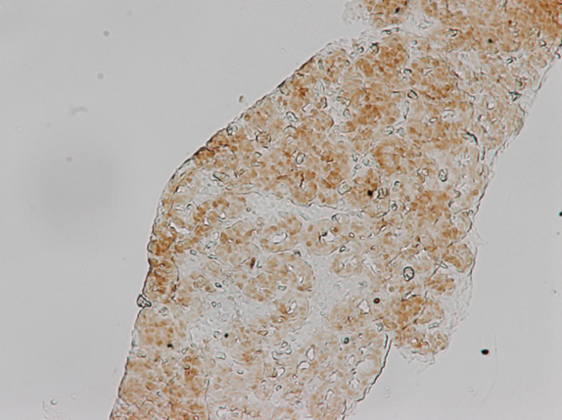
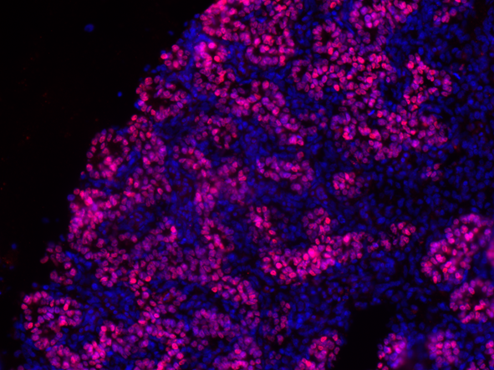
ReliaTech GmbH
Rabbit anti-human Prox-1
(Cat #102-PA32AG)
Prox1
Prox1/DAPI
Figure 1: Prox1 protein in E15 chick pancreas tissue detected by immunohistochemistry studies (IHC) using a polyclonal rabbit anti-human Prox1 antibody (Cat# 102-PA32AG). [diluted: 1:400]
Figure 2: Prox1 protein in E15 chick pancreas tissue detected by immunofluorescence studies (IF) using a polyclonal rabbit anti-human Prox1 antibody (Cat# 102-PA32AG). [diluted: 1:200]
The experiments were performed by Andreia Margarido
(de Santa Barbara’s team)
INSERM U1046, Montpellier, France
http://www.reliatech.de / orders@reliatech.de

